Slide 1
Active Database Concepts and Triggers
Presented By:
Brunda G

Slide 2
Agenda
Active Databases
Triggers
Generalized Model for Active Databases
Syntax for Triggers
Variations of Row level triggers
Example for triggers
Potential Applications for Active Databases

Slide 3
Active Databases
What is Active Database?
An active database is a database that includes an event-driven architecture (often in the form of ECA rules) which can respond to conditions.
What are Triggers?
Triggers are the SQL codes, that are automatically executed in response to certain events on the particular tables.
Triggers are written to be executed in response to any of the following events.
A database manipulation (DML) statement (DELETE, INSERT, or UPDATE).
A database definition (DDL) statement (CREATE, ALTER, or DROP).
A database operation (SERVERERROR, LOGON, LOGOFF, STARTUP, or SHUTDOWN).

Slide 4

Understanding Triggers

Slide 5
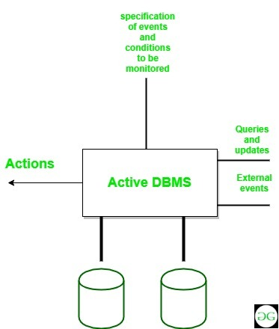
Generalized Model for Active Databases and Oracle Triggers
ECA Model
A rule in a ECA model contains three components:
Event
Condition
Action

Slide 6
Syntax of Triggers
Trigger Event | OLD | NEW
INSERT | No | Yes
UPDATE | Yes | Yes
DELETE | Yes | No
Create Trigger Trigger_Name
(Before | After) [ Insert | Update | Delete]
on [Table_Name]
[ for each row | for each column ]
[ trigger_body ]

Slide 7
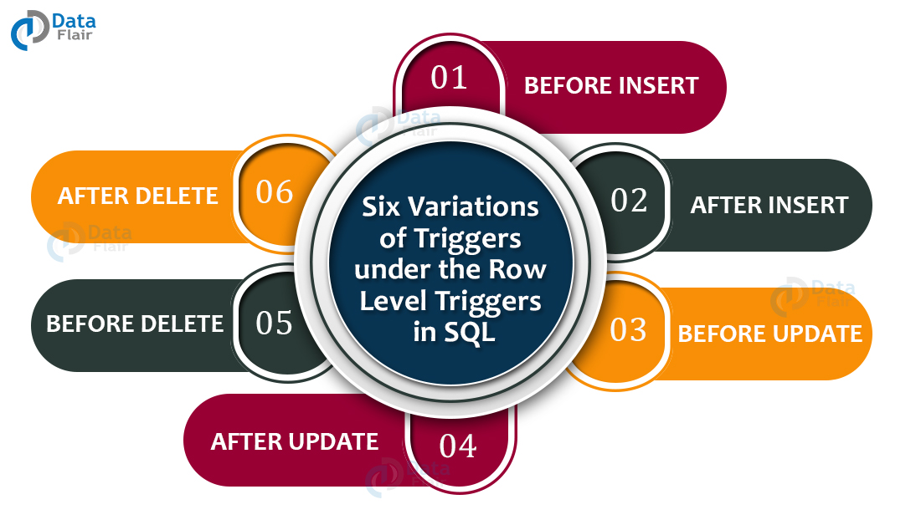
Variations of Row Level Triggers

Slide 8
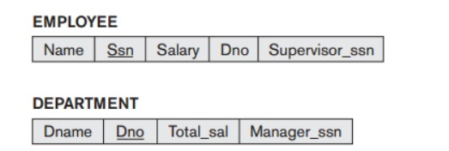
Example for Triggers
First we have to determine the events that may cause a change in the value of Total_sal, which are as follows:
1. Inserting (one or more) new employee tuples
2. Changing the salary of (one or more) existing employees
3. Changing the assignment of existing employees from one department to another
4. Deleting (one or more) employee tuples

Slide 9
STEPS
Step 1: Create database
Step 2: Create tables
Step 3: Create trigger
Step 4: Insert the values into table employees(here the dno foreign key can be NULL, indicating that the employee added is not yet assigned with department).
Step 5: Insert the values into table department
Step 6: Now insert the new employee records (who belong to the same department), into the table employee by assigning the department.
Step 7: Now check for the Total_sal attribute in the department relation.
Step 8: Total_sal value should be the sum of salaries of the employees who belongs to particular department.
Code: https://github.com/Brundagshetty/Triggers.git

Slide 10
Potential Applications for Active Databases
Allow notification of certain conditions that occur
Active rules can also be used to enforce integrity constraint

Slide 11


